Slide 1
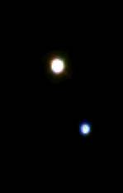
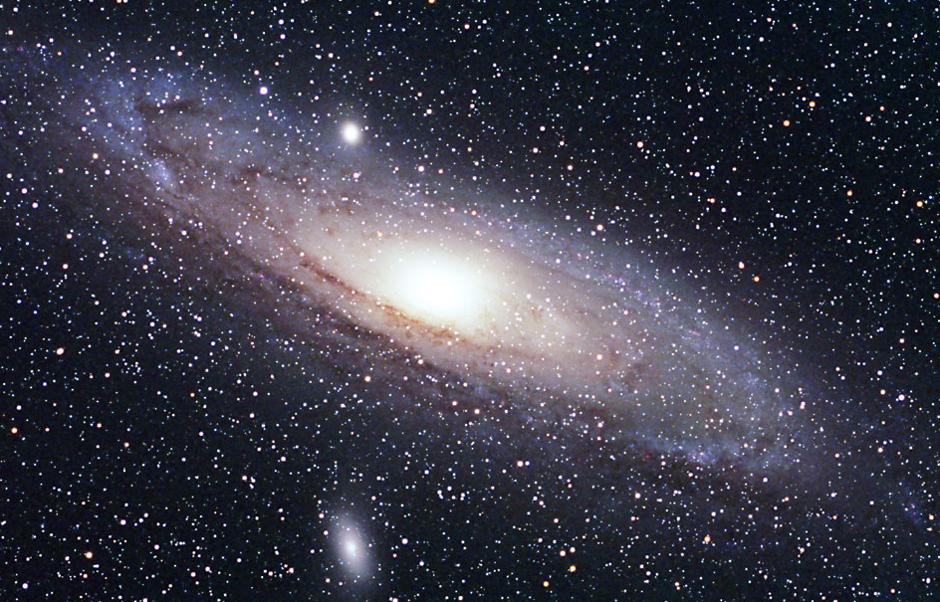
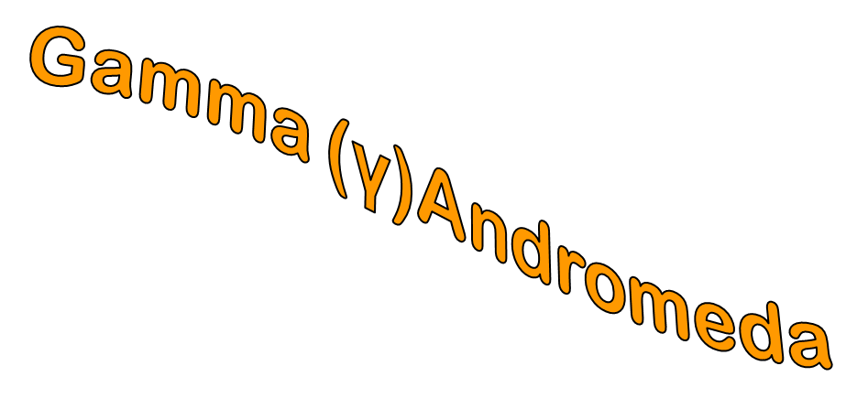
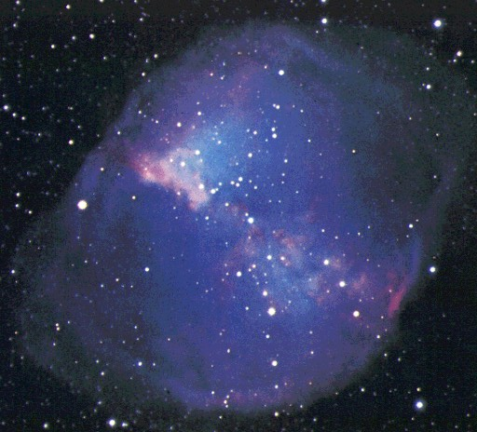
Exploring the Milky Way

Slide 2
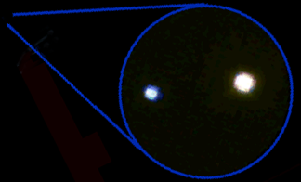
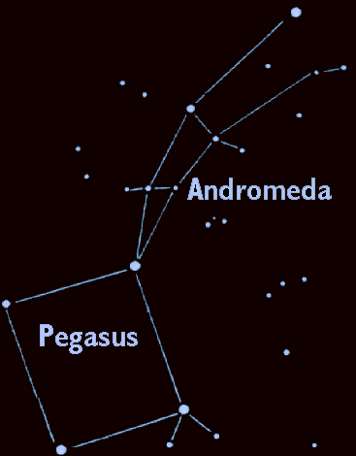
Gamma Andromedae
Through the Telescope
355 light years away in the constellation Andromeda – the “Chained Maiden”

Slide 3


A Pair of Stars
Gamma Andromeda (or Almach) when seen through the telescope is actually two stars.
Gamma 1
Gamma 2

Slide 4
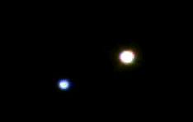

Star Pairs
Pairs of stars are one of two different types:
Optical Double Stars
Binary Stars

Slide 5
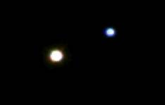

Optical Double Stars
Optical Double stars are just two stars that happen to lie in the same direction in the sky.
(A side view)
If you could see these stars from a different vantage point than Earth, you would see they actually have nothing to do with each other.

Slide 6


Binary or Multiple Stars
In a Binary (or Multiple) star system the stars are relatively close and orbit each other.

Slide 7

Multiple or Optical Double?
It's all in the distance.
Optical double stars are very large distances apart but appear to be close together because they are in the same line-of-sight.
Multiple stars lie close to each other in space and at about the same distance from Earth.

Slide 8
How Can You Find the Distance to a Star?
Earth
Nearby star
ρ
Background stars
Sun
d
ρ
Apparent positions of the nearby star for observations taken 6 months apart.
The position of a nearby star from different sides of our orbit around the Sun make it seem to shift in the sky. This shift, called parallax, can be used to find the distance to nearby stars.

Slide 9
Gamma Andromeda
The stars of Gamma Andromeda turn out to be 60 billion miles (0.01 light years) apart, making it a binary star system.
Gamma 1
Gamma 2

Slide 10
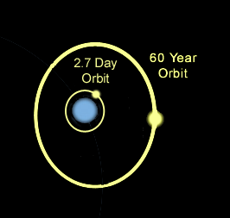
Gamma 2 - A Triple Star System!
Gamma 2 consists of 2 stars very close together that orbit each other every 2.7 days. A third star, much farther out, orbits those two every 60 years.

Slide 11
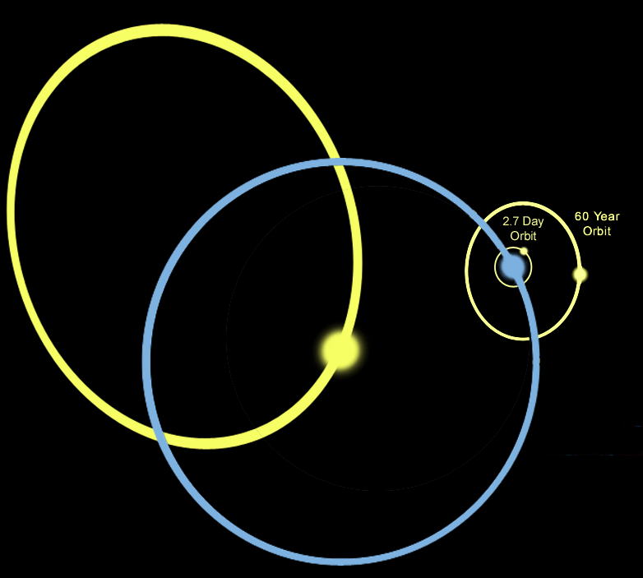
Gamma Andromeda - A 4 Star System!
Thus Gamma Andromeda is actually a 4 star system.
Multiple star
systems are very common in our galaxy.

Slide 12
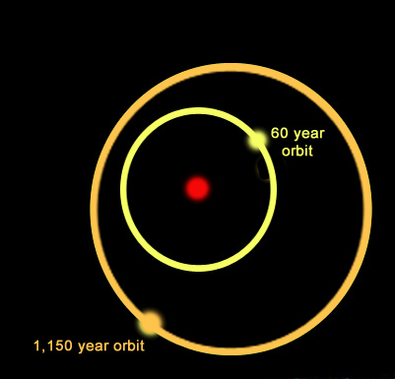
Multiple Star Systems
Star systems come in many varieties. For example, the system shown here is a triple star system:
A yellow star orbits a primary star with a period of nearly 60 years while a more distant companion orbits the inner pair with a period of 1,150 years.
One multiple star system we know of has 9 stars!

Slide 13
Stars Can Be Different Colors
Stars form with different amounts of hydrogen. High-mass stars have lots of hydrogen so they burn hotter and faster than stars with less fuel.
Thus high-mass stars have different temperatures, colors and life-spans than low-mass stars.

Slide 14
Contrast Multiple Stars
A multiple star system can have different colored stars orbiting each other. Here is a binary with a blue star and a yellow star
Blue stars are more massive and hotter than yellow or red stars. Stars of different masses evolve differently.

Slide 15
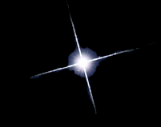

Types of Middle-Aged Stars
Blue stars are
high-mass hot stars.
Yellow stars, similar to our Sun, are average in mass and temperature.
Red stars are
low mass and cool.

Slide 16
Contrast Multiple Stars
Can you identify:
Which star is brightest?
Which star is hottest?
Which star is largest?

Slide 17
Contrast Multiple Stars
The blue star is the hotter of the two, yet the yellow star is the brightest.

Slide 18
Contrast Multiple Stars
How can a star be brighter if it is putting out less heat?

Slide 19
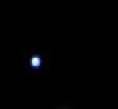
How can that be?
There are two possibilities:
If it is an Optical Double, the cooler star may be nearer to Earth.
If it is a Multiple star, the cooler star may be larger.

Slide 20
Contrast Multiple Stars
Gamma Andromeda is a multiple star, so the two stars are effectively the same distance from us.
Therefore, if the yellow star (Gamma 1) is brighter, then it must be larger.
Gamma 1 is starting to die, so it is turning into a giant.

